Slide 1
Watch Me Whip
Group 2

Slide 2
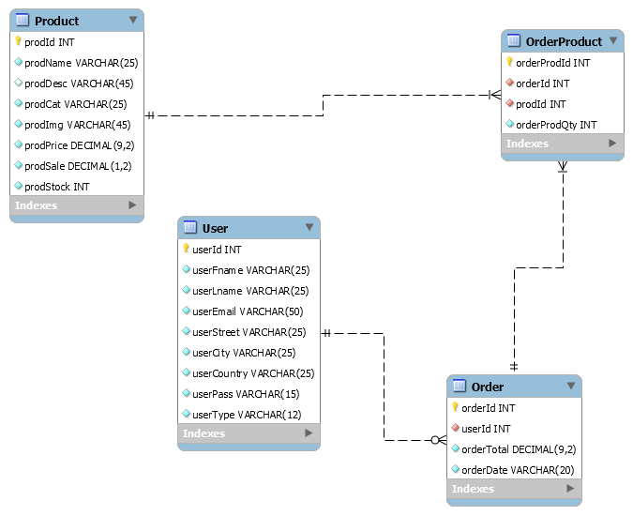
Entity Relationship Diagram

Slide 3
Watch Me Whip
Login
Register
Browse Products
- Per Category
Add to Cart
Checkout

Slide 4
Servlets
Login Servlet
Register Servlet
Edit Servlet
Delete Servlet

Slide 5
Listener
UserListener
Filter
BlacklistFilter

